Slide 1
Figure & Scheme Work Form
Work Form
Institution
Name
E-mail Address
Contact
Affiliation (Company/University) : UNIST
Name : Steven Williams
Mail : Steven.W@gmail.com
Contact : 010-1234-5678

Slide 2
Gray text serves as an example.
The included images and content are examples to assist in creating your request.
Size
Work style
Due Date
Print Image Size :
Working Style :
Deadline :
208 x 204.5 (mm)
300 dpi
"Individual images will be created with the shorter side set to 2000px."
3D graphic
8月 31日

Slide 3
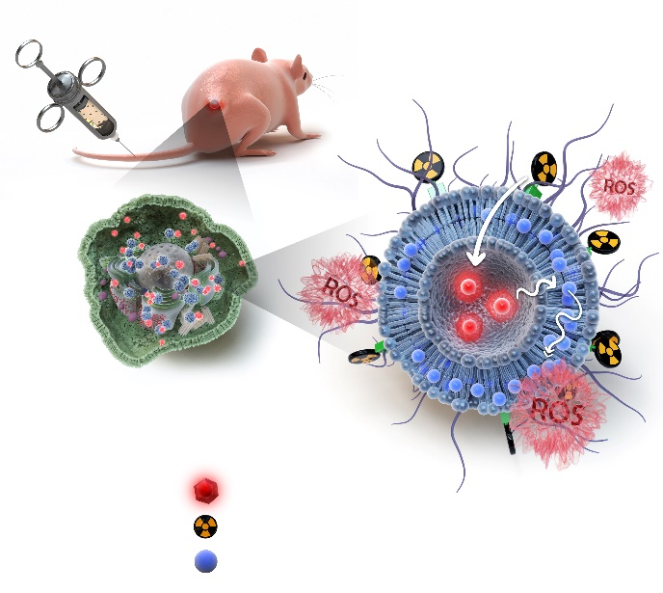
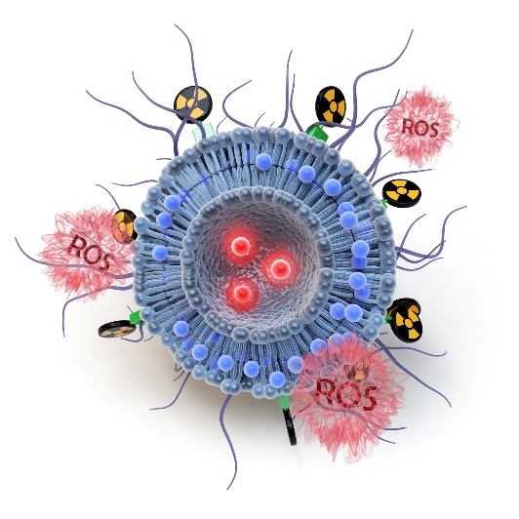
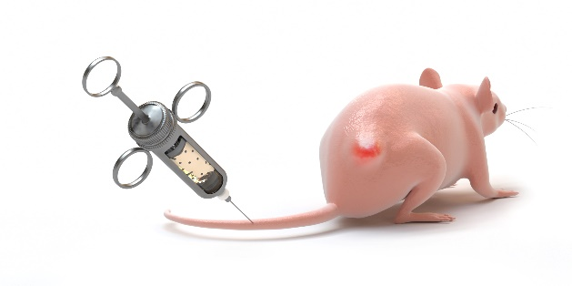
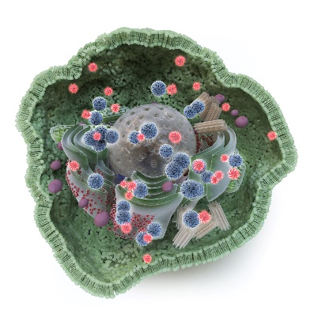
Before Sketching (Figure/scheme)
If it's a Figure/scheme
Overall layout sketch completion
Sketches for each cut All are required.
*An overall layout sketch is necessary to adjust the flow, composition, and emphasis of the entire drawing.
This step is essential because it requires verification against the actual print specifications.
*For sketches of each cut, please draw as detailed as possible to express the details.
*Overall Example *Image by Cut Example

Slide 4
Please refer to this. (Figure/scheme)
In the case of a figure/scheme, the background is often transparent or white.
When light needs to be represented in such cases, there are often more limitations compared to a cover.
(This is based on the same principle that light is not easily visible in bright areas. Darkness is needed for light to be seen.)
Transparent materials have similar tendencies.
To clearly express the content of your research, please simplify the parts that need "explanation." (The printed size is much smaller than you might think. You can see it in a large 2000px image, but when you check the actual print,
the core content is often not visible.)
For figures/schemes, revisions are often repeated, and the estimate may change depending on the number of revisions.
(If the estimate changes, we will inform you in advance.)

Slide 5
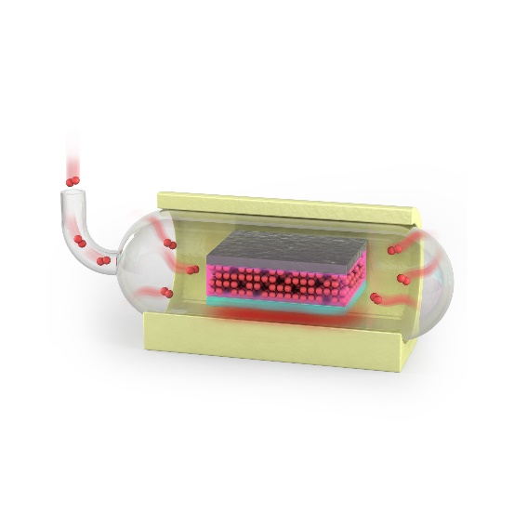
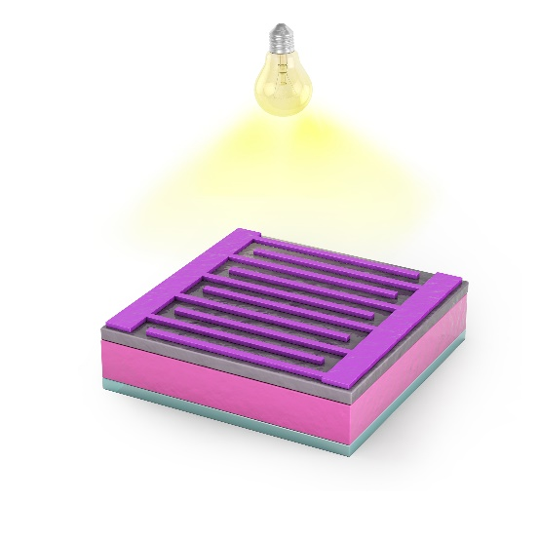
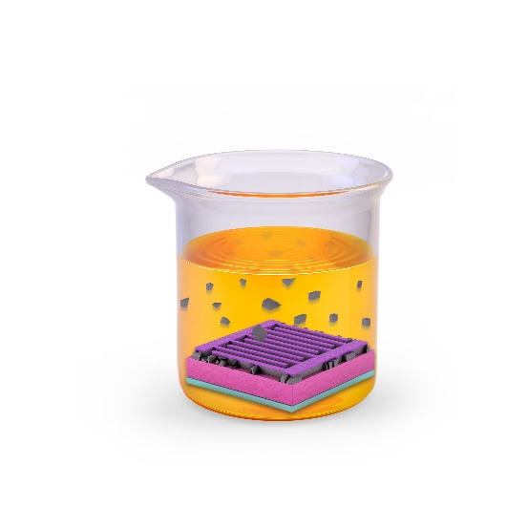
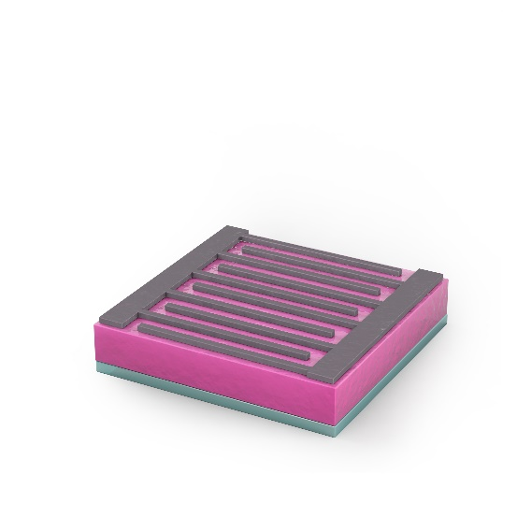
Overall Sketch of the Figure
The above image is an example of creation.

Slide 6
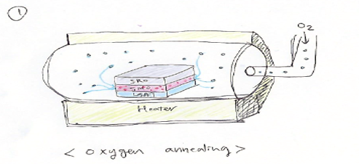
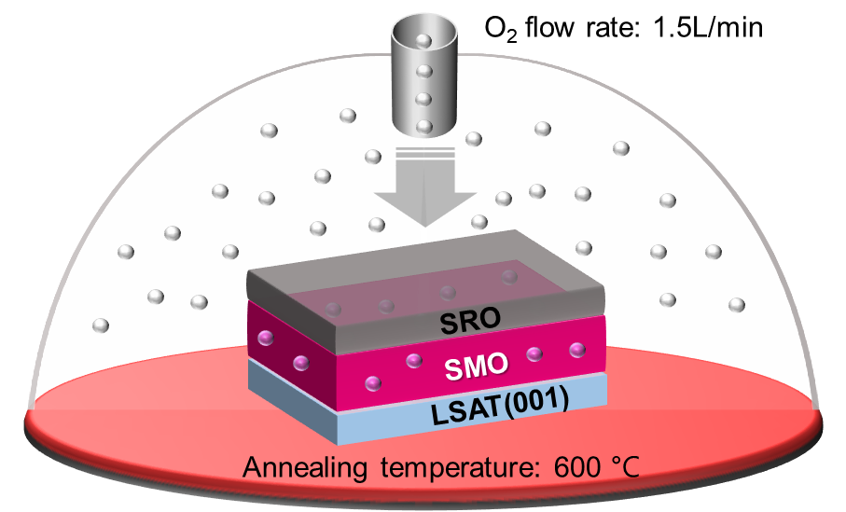
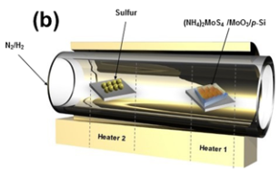
資料は白い領域にだけ入れてください。
Element 1. Oxygen annealing (Actual keyword or name for Googling)
Oxygen annealing
In a round tube (sealed), the sample is positioned in the middle, oxygen flows through the tube, and heat is emitted from the part labeled "Heater" creating a high-temperature environment.
The SMO thin film in the sample has partially vacant oxygen sites.
It is necessary to depict the image of oxygen injected into the tube filling the vacant oxygen sites in the SMO.
Details
Components :
Texture :
Size, Proportion :
Color :
Others :
Protein code :
資料は白い領域にだけ入れてください。
資料は白い領域にだけ入れてください。
Please refer to the drawing I made arbitrarily when drawing the sample! (Maintaining the colors of the thin films with vacant oxygen sites in SMO)
Molecular structure formula attached*ChemDraw
Protein code from https://www.rcsb.org/
Example of drawing a tube furnace, please refer to it
Ours has oxygen coming through a sealed tube!
Tip. Fill the left side with the reference image. The more, the better. We will do the enlargement. (Ex, SEM, TEM, blueprint, figure, scheme, etc. Any puzzle piece for visualization is fine.) If there is not enough space, create a page and put it in.
資料は白い領域にだけ入れてください。

Slide 7
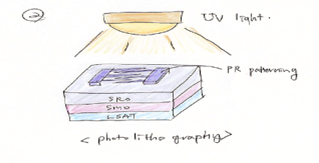
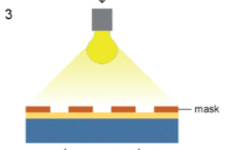
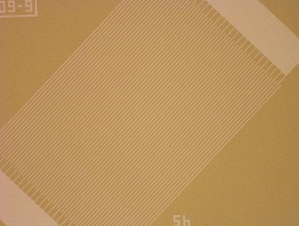
資料は白い領域にだけ入れてください。
Element 2. Photolithography (Actual keyword or name for Googling)
Photolithography
Sample number 1 has a pattern drawn with a substance called PR (which has a thickness like a thin film).
It is necessary to depict UV light being applied on top of it.
Details
Components :
Texture :
Size, Proportion :
Color :
Others :
Protein code :
資料は白い領域にだけ入れてください。
資料は白い領域にだけ入れてください。
Example of UV light being applied on patterned PR
Molecular structure formula attached*ChemDraw
Protein code from https://www.rcsb.org/
The actual pattern is dense, but please draw the electrodes large enough to make the pattern visible.
It would be good if the protruding parts are arranged to intersect five each.
Please also refer to example number 4 below.
Tip. Fill the left side with the reference image. The more, the better. We will do the enlargement. (Ex, SEM, TEM, blueprint, figure, scheme, etc. Any puzzle piece for visualization is fine.) If there is not enough space, create a page and put it in.
資料は白い領域にだけ入れてください。

Slide 8
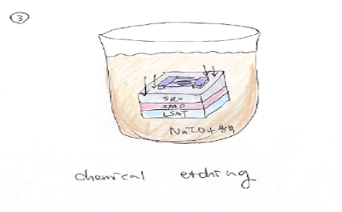
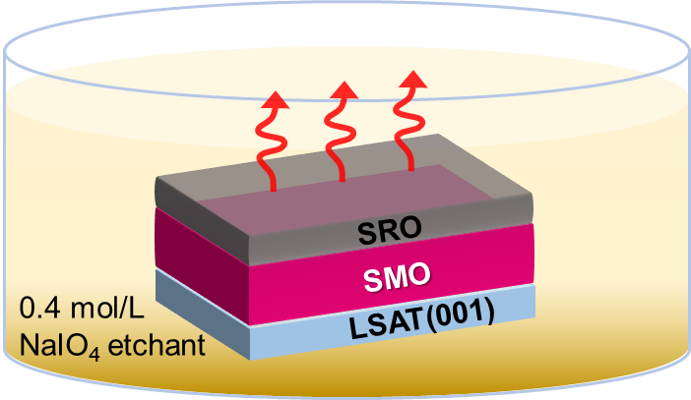
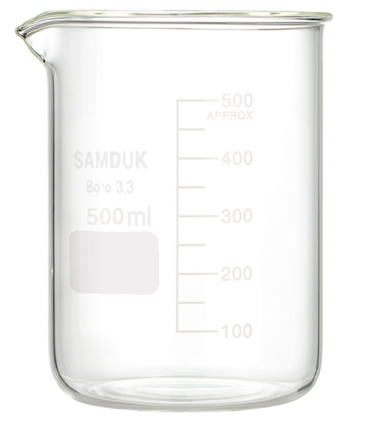
資料は白い領域にだけ入れてください。
Element 3. Chemical etching (Actual keyword or name for Googling)
Details
Components :
Texture :
Size, Proportion :
Color :
Others :
Protein code :
Chemical etching
Put NaIO4 in the beaker and put two samples.
And I would like to express that the layer called SRO is being cut along the shape of the thin film that has become a PR pattern.
(Or it may be expressed as melting and disappearing into a solution.)
資料は白い領域にだけ入れてください。
資料は白い領域にだけ入れてください。
Please refer to it when you draw a sample or a picture I drew on my own!
Different from the number one, the number two, three, and four, the SMO is filled with oxygen,
You have to show your pretty side.
Molecular structure formula attached*ChemDraw
Protein code from https://www.rcsb.org/
Example of a beaker
Tip. Fill the left side with the reference image. The more, the better. We will do the enlargement. (Ex, SEM, TEM, blueprint, figure, scheme, etc. Any puzzle piece for visualization is fine.) If there is not enough space, create a page and put it in.
資料は白い領域にだけ入れてください。

Slide 9
資料は白い領域にだけ入れてください。
Feel free to fill in a few useful elements
Free Form Page
資料は白い領域にだけ入れてください。
資料は白い領域にだけ入れてください。
Tip.
If you have anything to add or feel free to create, please create it.
資料は白い領域にだけ入れてください。

Slide 10
資料は白い領域にだけ入れてください。
Thank you!
We believe that effective communication can be achieved through work requests. However, in general, research is not conducted by individuals, so it is important to bring together multiple opinions. After the work is done, it often happens that the final decision maker changes all of the results. It causes unnecessary increase in estimates and wasted time. If you don’t mind, please ask all of the authors and those who have the right to make final decisions to obtain the consent of the work request form you have written.
資料は白い領域にだけ入れてください。
資料は白い領域にだけ入れてください。
I certify that the sketches and materials were created with
the consent of all corresponding authors and final decision makers.
date : 08/03/2020 Writer : John smith
資料は白い領域にだけ入れてください。

Slide 11
Thank you.

