Slide 1
WORK ORDER REQUEST FORM
Institution : UNIST
Last Name : Smith
First Name : John
E-mail : john.smith@unist.com
Contract : 821092067677

Slide 2
3D graphic :
2D Illustration:
Video:
ect :
Figure, Scheme
Cover image
TOC
etc
Figure, Scheme
Cover image
TOC
etc
Video
ect
Tip. Please change the color of text which you want to request

Slide 3
Publisher :
Journal :
Size :
Due date :
Wiley
Advanced Sustainable System
A4 or US letter
< 210 x 297 (mm) >
min 300 dpi
08-10-2020
Tip.
We will send your work 2-3 days before submission. If you fill out the request form correctly, you will surely get the results you want. Please note that there is a very high possibility that other schedules will be scheduled after the submission date.

Slide 4
Summary:
This study is a thesis on the seawater battery system, and includes the features, structure, and
performance of the first designed large-area seawater battery. The seawater battery is a secondary
battery system that is driven in seawater (or salt water) and can be charged/discharged.
The cover image requested includes the following concepts:
1. Can be driven in seawater
2. Eco-friendly
3. Power storage device
Tip.
Please briefly write down the core content of the research or the differences from other researches. It would be nice to think of it as a movie synopsis. Please write it in the square box for the core content only. I think it would be better if it were 1 or 2 sentences.

Slide 5
Before the sketch...
We respect your work for many years of devotion. And we try to understand both the passion and affection you feel for your study. Nonetheless, there are some requirements for your work to effectively represent your research and lead to cover selection.
The main component must occupy at least 1/3 of the area.
Other components should be minimized to make the main component stand out.
We have to put weight on the core content through bold omission.
If all elements fit into the picture, it may cause confusion for the viewer and may be omitted from the cover selection.
A picture with an intensely eye-catching theme can make the viewer feel strong curiosity.

Slide 6
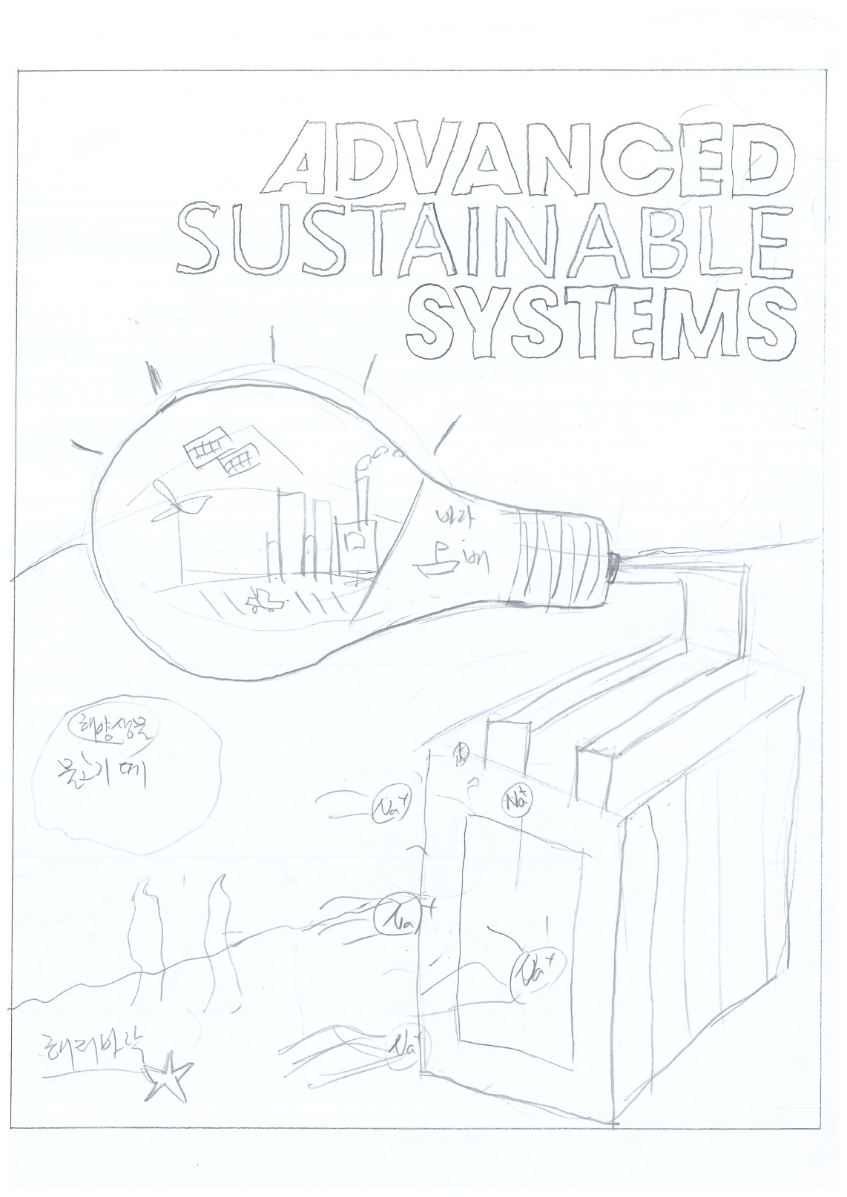
Please put your data only in the white area
SKETCH
Elements
1. Seawater battery module
2. Light bulb (lit)
3. Application field
4. Shoal of fish
5. Seabed
6. Marine life (starfish, coral reef, etc.)
2
3
Please put your data only in the white area
Please Put your data only in the white area
1
Tip.
Before explaining all the elements you drew on the sketch,
please number them and write their names.
Please check the drawing standard first (refer to the homepage)
and avoid sketching the journal logo.
4
6
5
Please put your data only in the white area

Slide 7
Please put your data only in the white area
SKETCH
Priority
1. Seawater battery module
2. Application field
3. Light bulb
3
2
Please put your data only in the white area
Please Put your data only in the white area
1
Tip.
Composition and weight distribution may change slightly
depending on priorities. (You just need to trust the designer's sense!)
Please put your data only in the white area

Slide 8
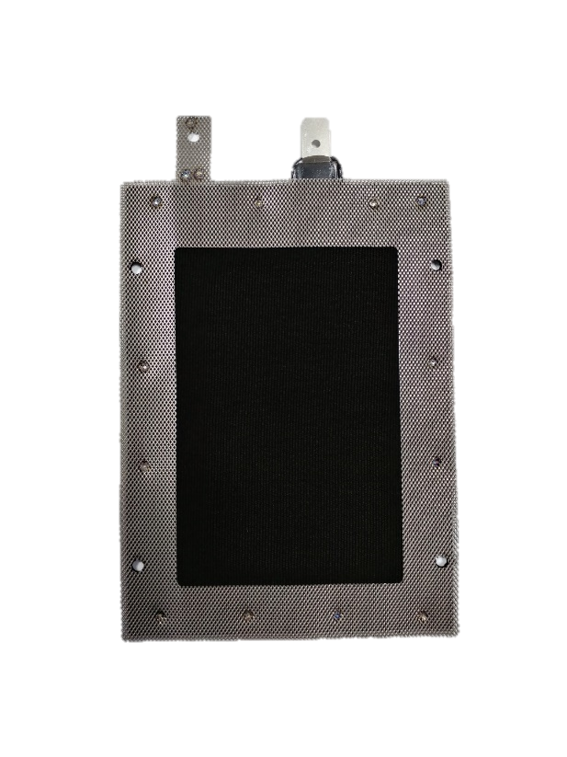
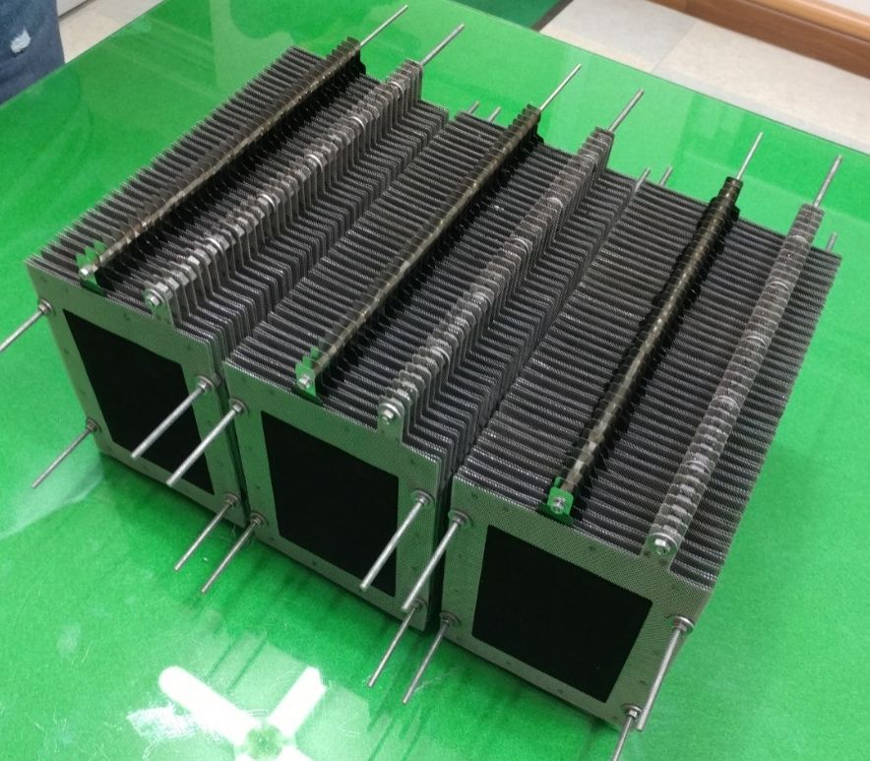
Please put your data only in the white area
Elements 1. battery cell (Actual keyword or name for Googling)
Detail
composition:
Texture :
Size or proportion :
ect:
Protein code from https://www.rcsb.org/ :
Please put your data only in the white area
Please Put your data only in the white area
Single cell of
Seawater battery
Seawater battery module
(stacking single cells)
Tip.
Fill the left side with the reference image. The more, the better. We will do the enlargement. (Ex, SEM, TEM, blueprint, figure, scheme, etc. Any puzzle piece for visualization is fine.) If there is not enough space, create a page and put it in.
Please put your data only in the white area

Slide 9
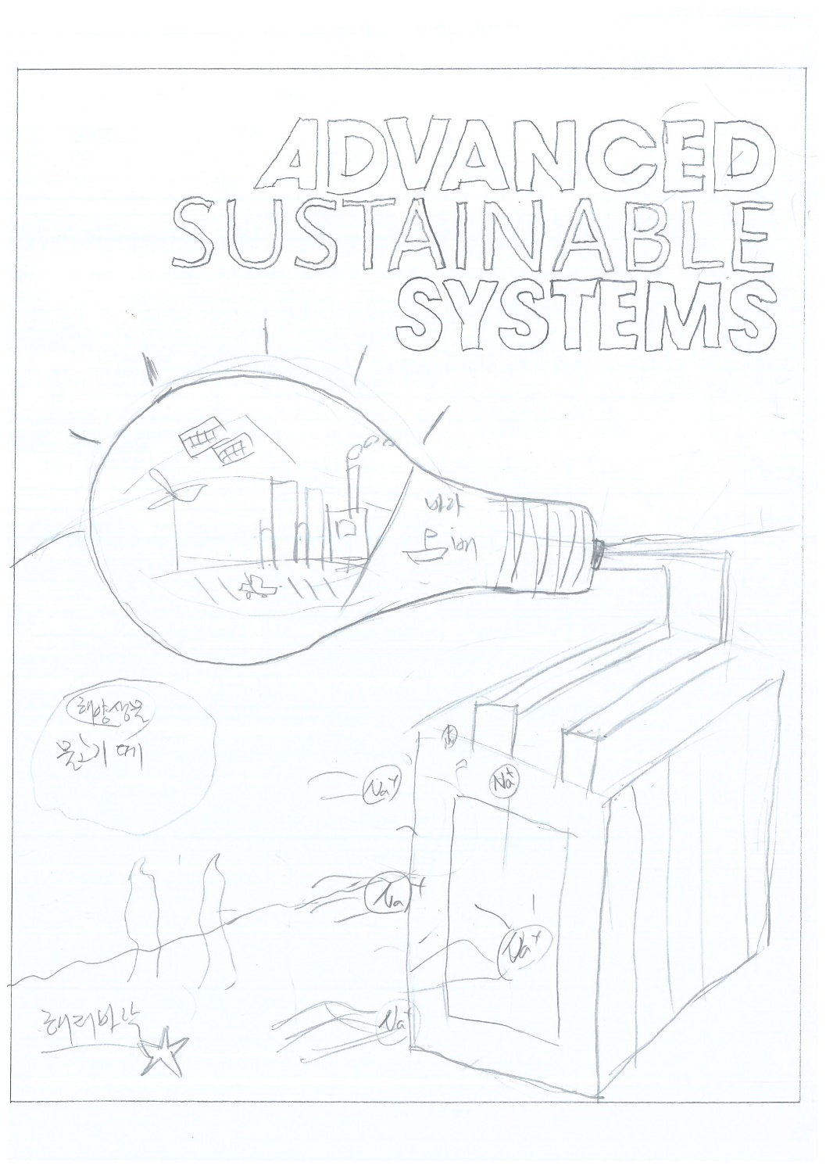
Please put your data only in the white area
Free form page. (Feel free to fill in some helpful elements)
< Brief description >
Includes aquatic organisms and seabed to emphasize that seawater cells are driven in the sea.
Expressing eco-friendliness by drawing small groups of fish
Light a light bulb to express that it is an energy storage device, and express various fields that can be applied to the inside of the light bulb (ESS, ship power, light buoy, etc.)
Please put your data only in the white area
Please Put your data only in the white area
<Requirment>
I lowered it in case the inside of the light bulb was covered by the journal title, but the top was too empty. I hope you can raise the light bulb or fill in the top background.
The color, background, and composition I have presented can be changed if necessary.
Please put your data only in the white area

Slide 10
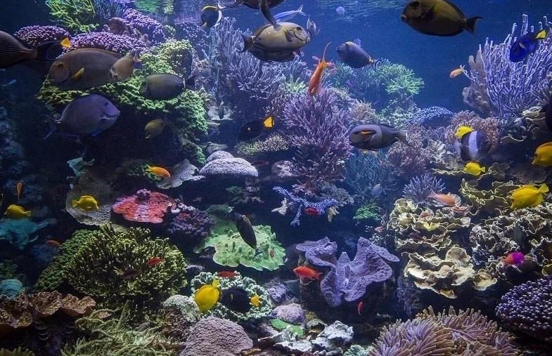
Please put your data only in the white area
Free form page. (Feel free to fill in some helpful elements)
1. Background
Wave foam expression on the boundary side
Sky
(Dark sky)
Please put your data only in the white area
Please Put your data only in the white area
Draw the bottom of the sea below to emphasize
that it is underwater
underwater
Underwater creatures such as starfish, coral reef & seaweed Includes 4~7 (not too complicated)
Please put your data only in the white area

Slide 11
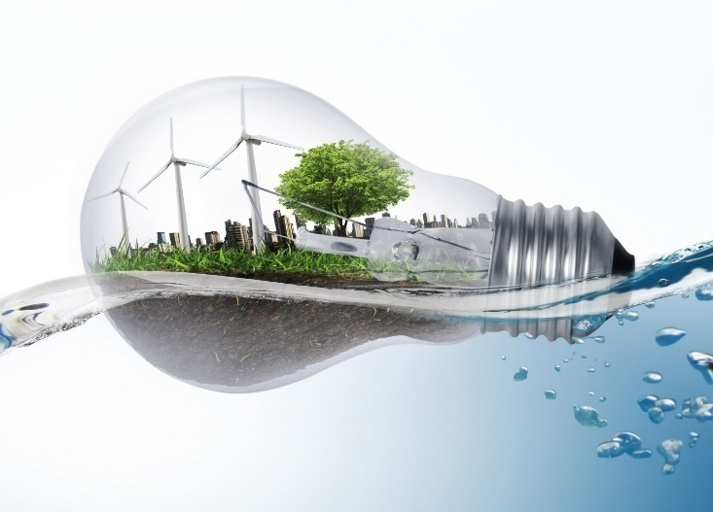
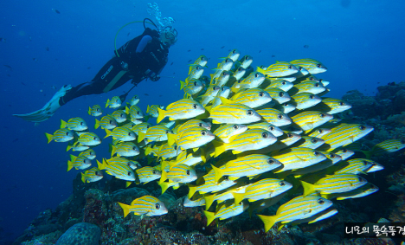
Please put your data only in the white area
Free form page. (Feel free to fill in some helpful elements)
1. Device
Light bulb and city inside (expressing that it is an energy storage device)
Please put your data only in the white area
Please Put your data only in the white area
Orange light on the surface of the bulb
Make sure that the seawater surface passes in front of the bulb as shown above.
Indication of applicable fields inside the bulb
-Wind power generation
-Solar power generation
-Lighted building or factory
-Ship etc.
School of fish (expressing that it is eco-friendly)
(Not important as part of the background)
Please put your data only in the white area

Slide 12
Please put your data only in the white area
Free form page. (Feel free to fill in some helpful elements)
2. Device
Seawater battery module
black
red
Connect between Light bulb
and battery (red/black)
Please put your data only in the white area
Please Put your data only in the white area
Module in which single cells of seawater battery are stacked (no matter the number of cells, appropriately)
As shown in the picture on the right, Na+ ions from seawater enter the cell.
Electricity or lightning representation on the cell surface as shown on the right
I hope it will have a more rich effect than the picture on the right
Please put your data only in the white area

Slide 13
Please put your data only in the white area
Thank you!
We believe that effective communication can be achieved through work requests. However, in general, research is not conducted by individuals, so it is important to bring together multiple opinions. After the work is done, it often happens that the final decision maker changes all of the results. It causes unnecessary increase in estimates and wasted time. If you don’t mind, please ask all of the authors and those who have the right to make final decisions to obtain the consent of the work request form you have written.
Please put your data only in the white area
Please Put your data only in the white area
I certify that the sketches and materials were created with
the consent of all corresponding authors and final decision makers.
date : 08/03/2020 Writer: John smith
Please put your data only in the white area

Slide 14
자료는 흰색영역에만 넣어주세요.
Thank you.
자료는 흰색영역에만 넣어주세요.
자료는 흰색영역에만 넣어주세요.
자료는 흰색영역에만 넣어주세요.

